Slide 1
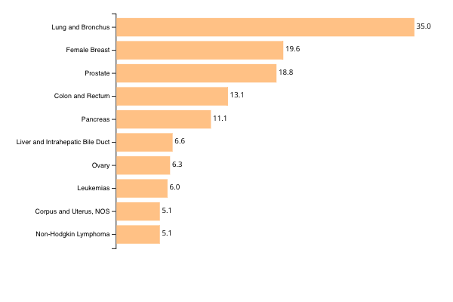
Top 10 Cancers by Rates of Cancer Deaths
United States, 2016-2020, All Races and Ethnicities, Male and Female
Rate per 100,000 people
Source - U.S. Cancer Statistics Working Group. U.S. Cancer Statistics Data Visualizations Tool, based on 2022 submission data (1999-2020): U.S. Department of Health and Human Services, Centers for Disease Control and Prevention and National Cancer Institute; https://www.cdc.gov/cancer/dataviz, released in November 2023.

